Slide 1
MIPS Architecture
In the following few slides we will discuss in detail the MIPS architecture and MIPS assembly language.

Slide 2

Stored Program Computers
The BIG Picture
Instructions represented in binary, just like data
Instructions and data stored in memory
Programs can operate on programs
  e.g., compilers, linkers, …
Binary compatibility allows compiled programs to work on different computers
  Standardized ISAs
Notes:
The University of Adelaide, School of Computer Science
Chapter 2 — Instructions: Language of the Computer

Slide 3
The ISA
Instruction Set Architecture
  The ISA defines the CPU, or a CPU family (e.g. x86)
    not only a collection of instructions,
    includes the CPU view of memory, registers number and roles, etc.
  The ISA is the contract between s/w and h/w
ISA ≠ CPU architecture (μ-architecture)
  E.g x86: Xeon ≠ Celeron, same ISA
Notes:
The University of Adelaide, School of Computer Science
Chapter 2 — Instructions: Language of the Computer

Slide 4
The MIPS ISA
Used as the example throughout the book
Stanford MIPS commercialized by MIPS Technologies (www.mips.com)
Large share of embedded core market
  Applications in consumer electronics, network/storage equipment, cameras, printers, …
Typical of many modern ISAs
See MIPS Reference Data tear-out card, and Appendixes B and
MIPS is a RISC
Notes:
The University of Adelaide, School of Computer Science
Chapter 2 — Instructions: Language of the Computer

Slide 5
MIPS ISA
Design principles
  small, regular & simple design ➔ fast
  make the common case fast
  good design requires good compromises
Features
  32 32-bit registers, r₀ = 0 always
  only load and store instructions access memory
  32-bit instructions, fixed size opcode, leftmost 6 bits
    fixed-field decoding
  all ALU operations are 3 address register operations
    add r1, r2, r3, meaning: r1 ⬅ r2 + r3

Slide 6
ISA MIPS Registers
Thirty-two 32-bit registers $0,$1,…,$31 used for
  integer arithmetic; address calculation; temporaries; special-purpose functions (stack pointer etc.)
A 32-bit Program Counter (PC)
Two 32-bit registers (HI, LO) used for mult. and division
Thirty-two 32-bit registers $f0, $f1,…,$f31 used for floating-point arithmetic
  Often used in pairs: 16 64-bit registers
Registers are a major part of the “state” of a process

Slide 7
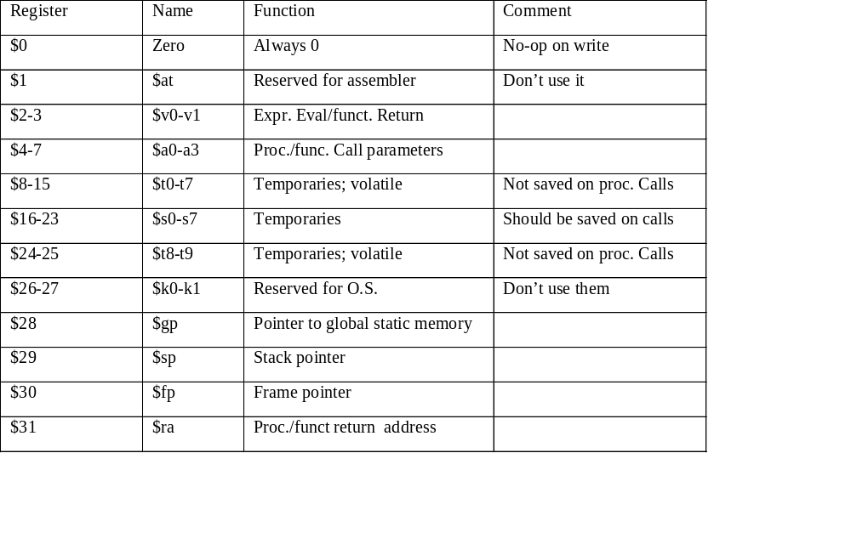
MIPS Register names and conventions

Slide 8
MIPS = RISC = Load-Store architecture
Every operand must be in a register
  Except for some small integer constants that can be in the instruction itself (see later)
Variables have to be loaded in registers
Results have to be stored in memory
Explicit Load and Store instructions are needed because there are many more variables than the number of registers

Slide 9
Example
The HLL statements
a = b + c
d = a + b
will be “translated” into assembly language as:
  load b in register rx
  load c in register ry
  rz <- rx + ry
  store rz in a # not destructive; rz still contains the value of a
  rt <- rz + rx
  store rt in d

Slide 10
MIPS Information units
Data types and size:
  Byte
  Half-word (2 bytes)
  Word (4 bytes)
  Float (4 bytes; single precision format)
  Double (8 bytes; double-precision format)
Memory is byte-addressable
A data type must start at an address evenly divisible by its size (in bytes)
In the little-endian environment, the address of a data type is the address of its lowest byte

Slide 11
Addressing of Information units
Memory data (alignment) addressees
3
2
1
0
Byte address 0
Half-word address 0
Word address 0
Byte address 2
Half-word address 2
Byte address 5
Byte address 8
Half-word address 8
Word address 8

Slide 12
MIPS Instruction types
Few of them (RISC philosophy)
Arithmetic
  Integer (signed and unsigned); Floating-point
Logical and Shift
  work on bit strings
Load and Store
  for various data types (bytes, words,…)
Compare (of values in registers)
Branch and jumps (flow of control)
  Includes procedure/function calls and returns

Slide 13
Notation for SPIM instructions
Opcode rd, rs, rt
Opcode rt, rs, immed
where
  rd is always a destination register (result)
  rs is always a source register (read-only)
  rt can be either a source or a destination (depends on the opcode)
  immed is a 16-bit constant (signed or unsigned)

Slide 14
Arithmetic instructions in SPIM
Don’t confuse the SPIM format with the “encoding” of instructions that we’ll see soon
Opcode Operands Comments
Add rd,rs,rt #rd = rs + rt
Addi rt,rs,immed #rt = rs + immed
Sub rd,rs,rt #rd = rs - rt

Slide 15
Examples
Add $8,$9,$10 #$8=$9+$10
Add $t0,$t1,$t2 #$t0=$t1+$t2
Sub $s2,$s1,$s0 #$s2=$s1-$s0
Addi $a0,$t0,20 #$a0=$t0+20
Addi $a0,$t0,-20 #$a0=$t0-20
Addi $t0,$0,0 #clear $t0
Sub $t5,$0,$t5 #$t5 = -$t5

Slide 16
Integer arithmetic
Numbers can be signed or unsigned
Arithmetic instructions (+,-,*,/) exist for both signed and unsigned numbers (differentiated by Opcode)
  Example: Add and Addu
  Addi and Addiu
  Mult and Multu
Signed numbers are represented in 2’s complement
For Add and Subtract, computation is the same but
  Add, Sub, Addi cause exceptions in case of overflow
  Addu, Subu, Addiu don’t
  How does the CPU know if the numbers are signed or unsigned?
It does not! You do (or the compiler does)
You have to tell the machine by using the right instruction (e.g. Add or Addu)

Slide 17
Instruction encoding
The ISA defines
  The format of an instruction (syntax)
  The meaning of the instruction (semantics)
Format = Encoding
  Each instruction format has various fields
  Opcode field gives the semantics (Add, Load etc …)
  Operand fields (rs,rt,rd,immed) say where to find inputs (registers, constants) and where to store the output

Slide 18
MIPS Instruction encoding
MIPS = RISC hence
  Few (3+) instruction formats
R in RISC also stands for “Regular”
  All instructions of the same length (32-bits = 4 bytes)
  Formats are consistent with each other on R-type or I type
    Opcode always at the same place (6 most significant bits)
    rs and rt always at the same place
    rd or immed follow.

Slide 19
I-type (immediate) format
An instruction with an immediate constant has the SPIM form:
  Opcode Operands Comment
  Addi $4,$7,78 # $4=$7 + 78
Encoding of the 32 bits:
  Opcode is 6 bits
  Since we have 32 registers, each register “name” is 5 bits
  This leaves 16 bits for the immediate constant
rs
immed
Opc
rt

Slide 20
I-type format example
  Addi $a0,$12,33 # $a0 is also $4 = $12 +33
  # Addi has opcode 08
Opc rs rt immed
08 12 4 33
31 25 20 15 0
In hex: 21840021

Slide 21
Sign extension
Internally the ALU (adder) deals with 32-bit numbers
What happens to the 16-bit constant?
  Extended to 32 bits
If the Opcode says “unsigned” (e.g., Addiu)
  Fill upper 16 bits with 0’s
If the Opcode says “signed” (e.g., Addi)
  Fill upper 16 bits with the msb of the 16 bit constant
    i.e. fill with 0’s if the number is positive
    i.e. fill with 1’s if the number is negative

Slide 22
R-type (register) format
Arithmetic, Logical, and Compare instructions require encoding 3 registers.
Opcode (6 bits) + 3 registers (5x3 =15 bits) => 32 -21 = 11 “free” bits
Use 6 of these bits to expand the Opcode
Use 5 for the “shift” amount in shift instructions
Opc rs rt rd sht func

Slide 23
R-type example
Sub $7,$8,$9
Opc =0, funct = 34
rs rt rd
0 8 9 7 0 34
Unused bits

Slide 24
Load and Store instructions
MIPS = RISC = Load-Store architecture
  Load: brings data from memory to a register
  Store: brings data back to memory from a register
Each load-store instruction must specify
  The unit of info to be transferred (byte, word etc. ) through the Opcode
  The address in memory
A memory address is a 32-bit byte address
An instruction has only 32 bits so ….

Slide 25
Addressing in Load/Store instructions
The address will be the sum
  of a base register (register rs)
  a 16-bit offset (or displacement) which will be in the immed field and is added (as a signed number) to the contents of the base register
Thus, one can address any byte within ± 32KB of the address pointed to by the contents of the base register.

Slide 26
Examples of load-store instructions
Load word from memory:
Lw rt,rs,offset #rt = Memory[rs+offset]
Store word to memory:
Sw rt,rs,offset #Memory[rs+offset]=rt
For bytes (or half-words) only the lower byte (or half-word) of a register is addressable
  For load you need to specify if it is sign-extended or not
  Lb rt,rs,offset #rt =sign-ext( Memory[rs+offset])
  Lbu rt,rs,offset #rt =zero-ext( Memory[rs+offset])
  Sb rt,rs,offset #Memory[rs+offset]= least signif. Byte of rt

Slide 27
Load-Store format
Need for
  Opcode (6 bits)
  Register destination (for Load) and source (for Store) : rt
  Base register: rs
  Offset (immed field)
Example
  Lw $14,8($sp) #$14 loaded from stack #stack + 8
35 29 14 8

Slide 28
Memory Operand Example 1
C code:
g = h + A[8];
  g in $s1, h in $s2, base address of A in $s3
Compiled MIPS code:
  Index 8 requires offset of 32
    4 bytes per word
lw $t0, 32($s3) # load word
add $s1, $s2, $t0
offset
base register
Notes:
The University of Adelaide, School of Computer Science
Chapter 2 — Instructions: Language of the Computer

Slide 29
Memory Operand Example 2
C code:
A[12] = h + A[8];
  h in $s2, base address of A in $s3
Compiled MIPS code:
  Index 8 requires offset of 32
lw $t0, 32($s3) # load word
add $t0, $s2, $t0
sw $t0, 48($s3) # store word
Notes:
The University of Adelaide, School of Computer Science
Chapter 2 — Instructions: Language of the Computer

Slide 30
Loading small constants in a register
If the constant is small (i.e., can be encoded in 16 bits) use the immediate format with Li (Load immediate)
Li $14,8 #$14 = 8
But, there is no opcode for Li!
Li is a pseudoinstruction
  It’s there to help you
  SPIM will recognize it and transform it into Addi (with sign-extension) or Ori (zero extended)
Addi $14,$0,8 #$14 = $0+8

Slide 31
Loading large constants in a register
If the constant does not fit in 16 bits (e.g., an address)
Use a two-step process
  Lui (load upper immediate) to load the upper 16 bits; it will zero out automatically the lower 16 bits
  Use Ori for the lower 16 bits (but not Li, why?)
Example: Load the constant 0x1B234567 in register $t0
  Lui $t0,0x1B23 #note the use of hex constants
  Ori $t0,$t0,0x4567

Slide 32
How to address memory in assembly language
Problem: how do I put the base address in the right register and how do I compute the offset
Method 1 (most recommended). Let the assembler do it!
  .data #define data section
  xyz: .word 1 #reserve room for 1 word at address xyz
  …….. #more data
  .text #define program section
  ….. # some lines of code
  lw $5, xyz # load contents of word at add. xyz in $5
In fact the assembler generates:
Lw $5, offset ($gp) #$gp is register 28

Slide 33
Generating addresses
Method 2. Use the pseudo-instruction La (Load address)
La $6,xyz #$6 contains address of xyz
Lw $5,0($6) #$5 contains the contents of xyz
  La is in fact Lui followed by Ori
  This method can be useful to traverse an array after loading the base address in a register
Method 3
  If you know the address (i.e. a constant) use Li or Lui + Ori

Slide 34
Flow of Control -- Conditional branch instructions
You can compare directly
  Equality or inequality of two registers
  One register with 0 (>, <, ≥, ≤)
and branch to a target specified as
  a signed displacement expressed in number of instructions (not number of bytes) from the instruction following the branch
  in assembly language, it is highly recommended to use labels and branch to labeled target addresses because:
    the computation above is too complicated
    some pseudo-instructions are translated into two real instructions

Slide 35
Examples of branch instructions
  Beq rs,rt,target #go to target if rs = rt
  Beqz rs, target #go to target if rs = 0
  Bne rs,rt,target #go to target if rs != rt
  Bltz rs, target #go to target if rs < 0
  etc.
  but note that you cannot compare directly 2 registers for <, > …

Slide 36

Compiling If Statements
C code:
if (i==j) f = g+h;
else f = g-h;
  f, g, … in $s0, $s1, …
Compiled MIPS code:
bne $s3, $s4, Else
add $s0, $s1, $s2
j Exit
Else: sub $s0, $s1, $s2
Exit: …
Assembler calculates addresses
Notes:
The University of Adelaide, School of Computer Science
Chapter 2 — Instructions: Language of the Computer

Slide 37
Compiling Loop Statements
C code:
  while (save[i] == k) i += 1;
  i in $s3, k in $s5, address of save in $s6
Compiled MIPS code:
Loop: sll $t1, $s3, 2
add $t1, $t1, $s6
lw $t0, 0($t1)
bne $t0, $s5, Exit
addi $s3, $s3, 1
j Loop
Exit: …
Notes:
The University of Adelaide, School of Computer Science
Chapter 2 — Instructions: Language of the Computer

Slide 38
More Conditional Operations
Set result to 1 if a condition is true
  Otherwise, set to 0
slt rd, rs, rt
  if (rs < rt) rd = 1; else rd = 0;
slti rt, rs, constant
  if (rs < constant) rt = 1; else rt = 0;
Use in combination with beq, bne
  slt $t0, $s1, $s2 # if ($s1 < $s2)
  bne $t0, $zero, L # branch to L
Notes:
The University of Adelaide, School of Computer Science
Chapter 2 — Instructions: Language of the Computer

Slide 39
Comparisons between two registers
Use an instruction to set a third register
  slt rd,rs,rt #rd = 1 if rs < rt else rd = 0
  sltu rd,rs,rt #same but rs and rt are considered unsigned
Example: Branch to Lab1 if $5 < $6
  slt $10,$5,$6 #$10 = 1 if $5 < $6 otherwise $10 = 0
  bnez $10,Lab1 # branch if $10 =1, i.e., $5<$6
There exist pseudo instructions to help you!
  blt $5,$6,Lab1 # pseudo instruction translated into
  # slt $1,$5,$6
  # bne $1,$0,Lab1
  Note the use of register 1 by the assembler and the fact that computing the address of Lab1 requires knowledge of how pseudo-instructions are expanded

Slide 40
Branch addressing format
Need Opcode, one or two registers, and an offset
  No base register since offset added to PC
When using one register (i.e., compare to 0), can use the second register field to expand the opcode
  similar to function field for arith instructions
  beq $4,$5,1000
  bgtz $4,1000
Opc rs rt/func target offset

Slide 41
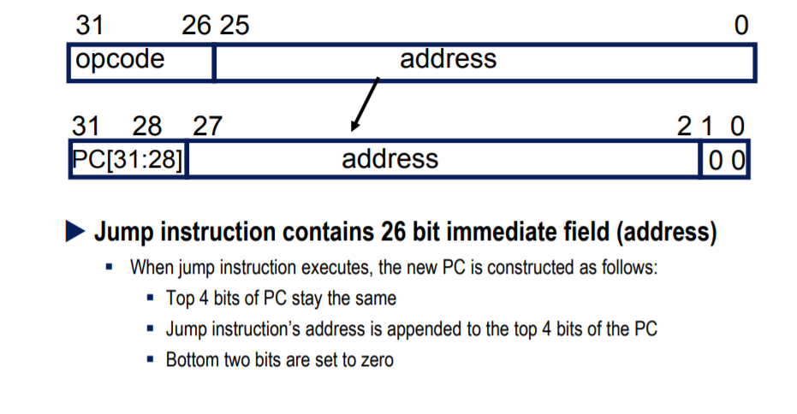
Unconditional transfer of control
Can use “beqz $0, target”
  Very useful but limited range (± 32K instructions)
Use of Jump instructions
  j target #special format for target byte address (26 bits)

Slide 42
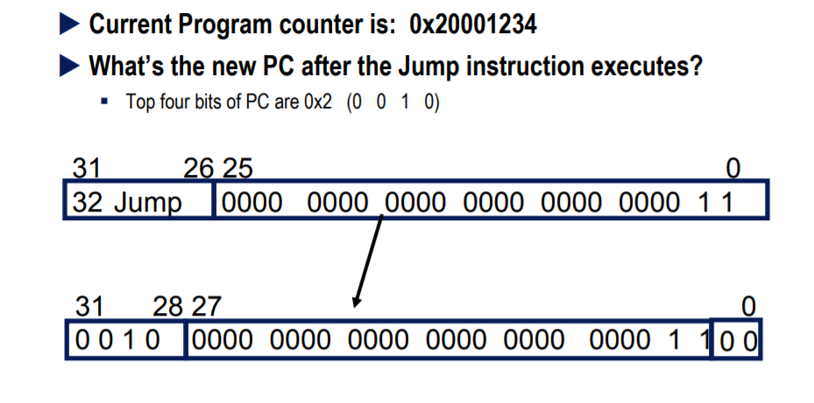
Jump Example

Slide 43
Other unconditioned branch instructions
  jr $rs #jump to address stored in rs
  (good for switch #statements and transfer tables)
Call/return functions and procedures
  jal target #jump to target address; save PC of #following instruction in $31 (aka $ra)
  jr $31 # jump to address stored in $31 (or $ra)
Also possible to use jalr rs,rd #jump to address stored in rs; rd = PC of following instruction in rd with default rd = $31

Slide 44
How to address operands
The ISA specifies addressing modes
MIPS, as a RISC machine has very few addressing modes
  register mode. Operand is in a register
  base or displacement or indexed mode
    Operand is at address “register + 16-bit signed offset”
  immediate mode. Operand is a constant encoded in the instruction
  PC-relative mode. As base but the register is the PC

Slide 45
Some interesting instructions. Multiply
Multiplying 2 32-bit numbers yields a 64-bit result
  Use of HI and LO registers
  Mult rs,rt #HI/LO = rs*rt
  Multu rs,rt
  Then need to move the HI or LO or both to regular registers
  mflo rd #rd = LO
  mfhi rd #rd = HI
  Once more the assembler can come to the rescue with a pseudo inst
  mul rd,rs,rt #generates mult and mflo
  #and mfhi if necessary

Slide 46
Some interesting instructions. Divide
Similarly, divide needs two registers
  LO gets the quotient
  HI gets the remainder
If an operand is negative, the remainder is not specified by the MIPS ISA.

Slide 47
Logic instructions
Used to manipulate bits within words, set-up masks etc.
A sample of instructions
  and rd,rs,rt #rd=AND(rs,rt)
  andi rd,rs,immed
  or rd,rs,rt
  xor rd,rs,rt
Immediate constant limited to 16 bits (zero-extended). If longer mask needed, use Lui.
There is a pseudo-instruction NOT
  not rt,rs #does 1’s complement (bit by bit #complement of rs in rt)

Slide 48
Example of use of logic instructions
Create a mask of all 1’s for the low-order byte of $6. Don’t care about the other bits.
  ori $6,$6,0x00ff #$6[7:0] set to 1’s
Clear high-order byte of register 7 but leave the 3 other bytes unchanged
  lui $5,0x00ff #$5 = 0x00ff0000
  ori $5,$5,0xffff #$5 = 0x00ffffff
  and $7,$7,$5 #$7 =0x00…… (…whatever was #there before)

Slide 49
Shift instructions
Logical shifts -- Zeroes are inserted
  sll rd,rt,shm #left shift of shm bits; inserting 0’s on #the right
  srl rd,rt,shm #right shift of shm bits; inserting 0’s #on the left
Arithmetic shifts (useful only on the right)
  sra rd,rt,shm # Sign bit is inserted on the left
Example let $5 = 0xff00 0000
sll $6,$5,3 #$6 = 0xf800 0000
srl $6,$5,3 #$6 = 0x1fe0 0000
sra $6,$5,3 #$6 = 0xffe0 0000

Slide 50
Example -- High-level language
int a[100];
int i;
for (i=0; i<100; i++){
a[i] = 5;
}

Slide 51
Assembly language version
Assume: start address of array a in r15.
We use r8 to store the value of i and r9 for the value 5
add $8,$0,$0 #initialize i
li $9,5 #r9 has the constant 5
Loop: mul $10,$8,4 #r10 has i in bytes
#could use a shift left by 2
addu $14,$10,$15 #address of a[i]
sw $9,0($14) #store 5 in a[i]
addiu $8,$8,1 #increment i
blt $8,100,Loop #branch if loop not finished
#taking lots of liberty here!

Slide 52
Machine language version (generated by SPIM)
[0x00400020] 0x00004020 add $8, $0, $0 ; 1: add $8,$0,$0
[0x00400024] 0x34090005 ori $9, $0, 5 ; 2: li $9,5
[0x00400028] 0x34010004 ori $1, $0, 4 ; 3: mul $10,$8,4
[0x0040002c] 0x01010018 mult $8, $1
[0x00400030] 0x00005012 mflo $10
[0x00400034] 0x014f7021 addu $14, $10, $15 ; 4: addu $14,$10,$15
[0x00400038] 0xadc90000 sw $9, 0($14) ; 5: sw $9,0($14)
[0x0040003c] 0x25080001 addiu $8, $8, 1 ; 6: addiu $8,$8,1
[0x00400040] 0x29010064 slti $1, $8, 100 ; 7: blt $8,100,Loop
[0x00400044] 0x1420fff9 bne $1, $0, -8 [Loop-0x00400044]

Slide 53
String Copy Example
C code (naïve):
  Null-terminated string
void strcpy (char x[], char y[])
{ int i;
i = 0;
while ((x[i]=y[i])!='\0')
i += 1;
}
  Addresses of x, y in $a0, $a1
  i in $s0
Notes:
The University of Adelaide, School of Computer Science
Chapter 2 — Instructions: Language of the Computer

Slide 54
String Copy Example
MIPS code:
strcpy:
addi $sp, $sp, -4 # adjust stack for 1 item
sw $s0, 0($sp) # save $s0
add $s0, $zero, $zero # i = 0
L1: add $t1, $s0, $a1 # addr of y[i] in $t1
lbu $t2, 0($t1) # $t2 = y[i]
add $t3, $s0, $a0 # addr of x[i] in $t3
sb $t2, 0($t3) # x[i] = y[i]
beq $t2, $zero, L2 # exit loop if y[i] == 0
addi $s0, $s0, 1 # i = i + 1
j L1 # next iteration of loop
L2: lw $s0, 0($sp) # restore saved $s0
addi $sp, $sp, 4 # pop 1 item from stack
jr $ra # and return
Notes:
The University of Adelaide, School of Computer Science
Chapter 2 — Instructions: Language of the Computer

Slide 55
Program and memory layout
By convention the layout is:
  Note that only half of the addressing
  space is taken by user
  Other half is O.S.
7fff ffff
Stack
Dynamic data
Static data
1000 0000
Program text
40000
Reserved

Slide 56
Program stack
Each executing program (process) has a stack
Stack = dynamic data structure accessed in a LIFO manner
Program stack automatically allocated by O.S.
At the start of the program, register $sp ($29 in Mips) is automatically loaded to point to the first empty slot on top of stack
  After that it will be your responsibility to manage $sp
By convention, stack grows towards lower addresses
  to allocate new space (i.e., when you push), decrement $sp
  to free space on top of stack (pop), increment $sp

Slide 57
Push operation
push adds an item on top of stack
  one instruction to manipulate the data, e.g. “sw $6,0($sp)”
  one instruction to adjust the stack pointer e.g., “addi $sp,$sp,-4”
46
-72
???
8($sp)
4($sp)
$sp
46
-72
127
???
12($sp)
8($sp)
4($sp)
$sp
127 $6
127 $6
before
after

Slide 58
Pop operation
pop removes the item on top of stack and stores it in a register
  one instruction to adjust the stack pointer e.g., “addi $sp,$sp,4”
  one instruction to manipulate the data, e.g. “lw $6,0($sp)”
46
-72
127
8($sp)
4($sp)
$sp
46
-72
127
???
12($sp)
8($sp)
4($sp)
$sp
Now this has become “garbage”
127 $6
453 $6
after
before

Slide 59
Procedures
Procedures/functions are the major program structuring mechanism
Calling and returning form a procedure requires a protocol between caller and callee
Protocol is based on conventions

Slide 60
Procedures/Functions -- Protocol
Each machine (compiler?) has its own set of protocol(s)
Protocol: combination of hardware/software
  e.g., “jal” is hardware
  use of register $29 as $sp is software
Protocol: sequence of steps to be followed at each call and each return
  controlled by hardware and/or software
In RISC machines
  hardware performs simple instructions
  software (compiler/assembler) controls sequence of instructions

Slide 61
Procedure call requirements (caller/callee)
Caller must pass the return address to the callee
Caller must pass the parameters to the callee
Caller must save what is volatile (registers) and could be used by the callee
Callee must save the return address (in case it becomes a caller)
Callee must provide (stack) storage for its own use
Caller/callee should support recursive calls

Slide 62
Mechanism
Registers are used for
  passing return address in $ra
    jal target
  passing a small number of parameters (up to 4 in $a0 to $a3)
  keeping track of the stack ($sp)
  returning function values (in $v0 and $v1)
Stack is used for
  saving registers to be used by callee
  saving info about the caller (return address)
  passing parameters if needed
  allocating local data for the called procedure

Slide 63
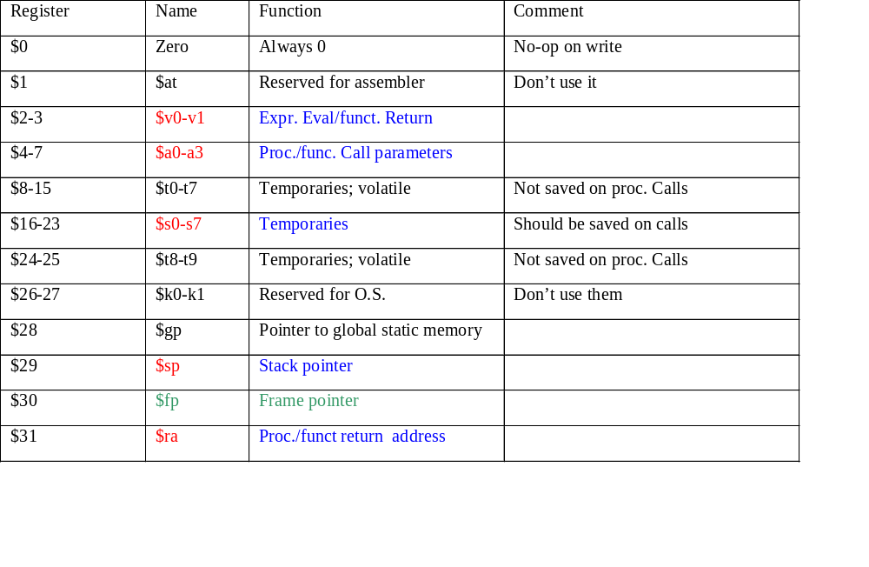
Procedure calls and register conventions

Slide 64
Who does what on a call (one sample protocol)
Caller
  Saves any volatile register ($t0-$t9) that has contents that need to be kept
  Puts up to 4 arguments in $a0-$a3
  If more than 4 arguments, pushes the rest on the stack
  calls with jal instruction
Callee
  saves $ra on stack
  saves any non-volatile register ($s0-s7) that it will use

Slide 65
Who does what on return
Callee
  restores any non-volatile register ($s0-$s7) it has used
  restores $ra
  puts function results in $v0-$v1
  adjusts $sp
  returns to caller with “jr $ra”
Caller
  restores any volatile register it had saved
  examines $v0-$v1 if needed

Slide 66
MIPS Simulator for Assembly Language homework (MARS)
Free program that you can download that helps you write and assemble programs in SPIM assembly language. There is a free downloads and the online documentation of the MARS simulator. The simulator is built on the SPIM assembler for MIPS, and there is generous, high-quality documentation of the MIPS assembly language with the free, online SPIM documentation for the MIPS assembler
Useful assembler directives:
.data: The following data items should be stored in the data segment.
.text: The next items are put in the user text segment. In SPIM, these items
may only be instructions or words ( see .word directive below)
.byte: b1, b2, …bn store the listed values in successive bytes in memory.
.half: h1, h2, …hn store the listed values in successive 16-bit in memory.
.word: w1, w2, …wn store the listed values in successive 32-bit in memory.
.asciiz “str” store the string in memorty an null terminate it.
Downlaod program and read documentation to start programming in SPIM.

Slide 67
Syscall Services
Service | $v0 | Arguments / Result
Print Integer | 1 | $a0 = integer value to print
Print Float | 2 | $f12 = float value to print
Print Double | 3 | $f12 = double value to print
Print String | 4 | $a0 = address of null-terminated string
Read Integer | 5 | $v0 = integer read
Read Float | 6 | $f0 = float read
Read Double | 7 | $f0 = double read
Read String | 8 | $a0 = address of input buffer $a1 = maximum number of characters to read
Exit Program | 10
Print Char | 11 | $a0 = character to print
Read Char | 12 | $a0 = character read
Supported by MARS

Slide 68
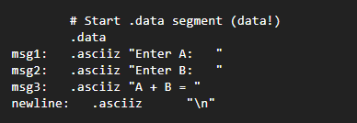
Input, output and computation program
Define data

Slide 69
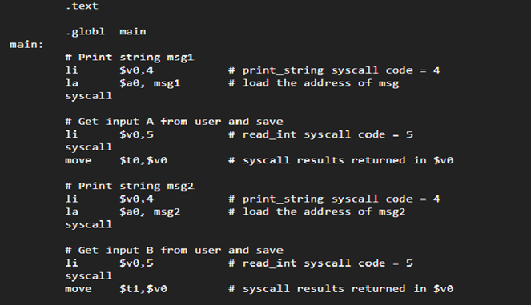
Get data form user

Slide 70
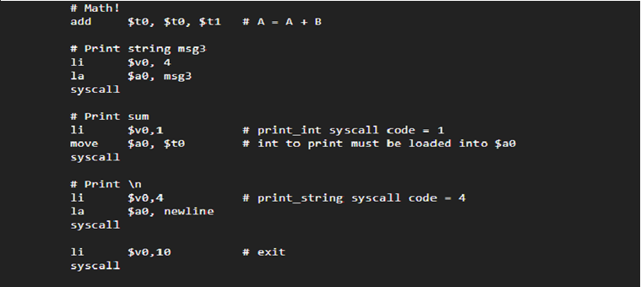
Do Math , Print results and Exit

